Slide 1
HOW TO INSPECT YOUR BEES
IN TODAYS WORLD OF
BEETLES
AND
MITES

Slide 2
HIVE INSPECTION
To have healthy, strong, honey producing hives, beekeepers must make inspections to know the conditions inside the hive.
Hive inspection is a simply term to describe:
  Taking the hive apart and making observations
  Then deciding what needs to be done, based upon those observations

Slide 3
HIVE INSPECTION
There are a number of things that need to looking for when inspecting a bee hive
Inspection sheets helps keeping things organized and allows easy comparison from one inspection to the next
Hive inspection checklist helps to keep beginners and forgetful folks from overlooking something important

Slide 4
HIVE INSPECTION CHECKLIST ITEMS
HIVE NUMBER
  Identify the hive
DATE
  Enter the date for each inspection
TEMPERATURE
  Enter the temperature when the hive inspection was done

Slide 5
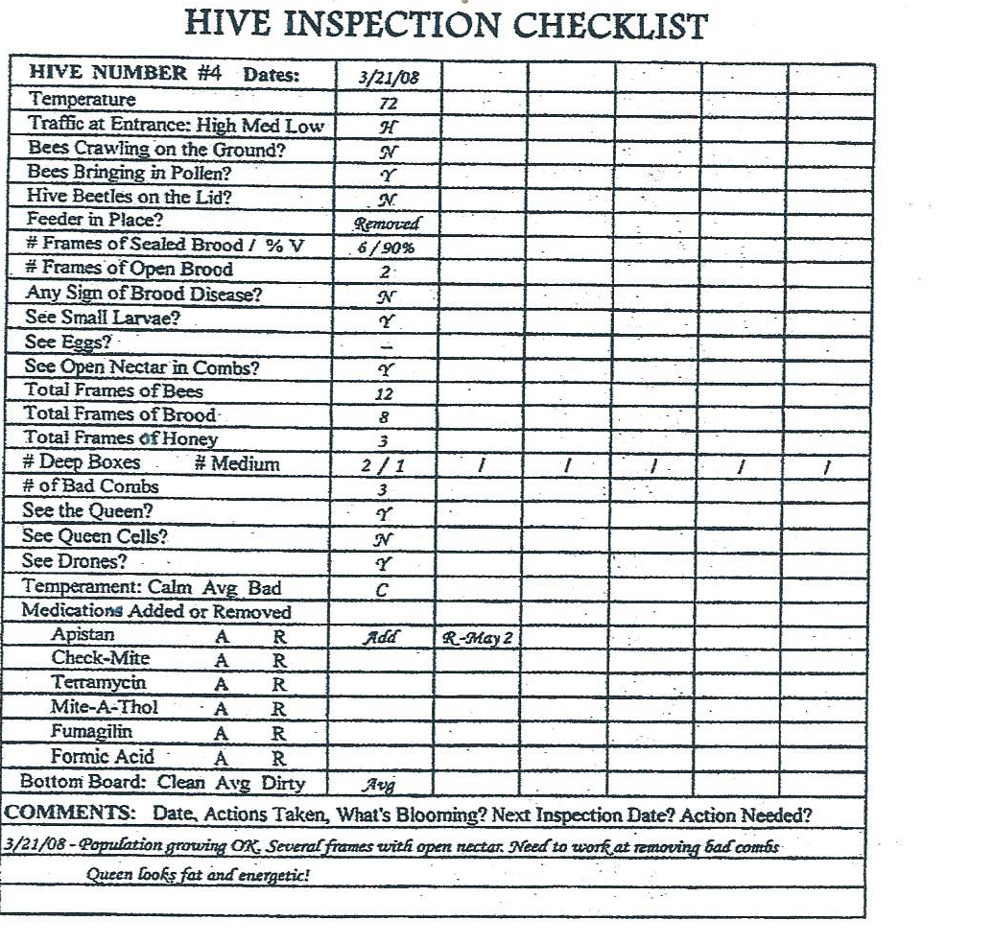

Slide 6
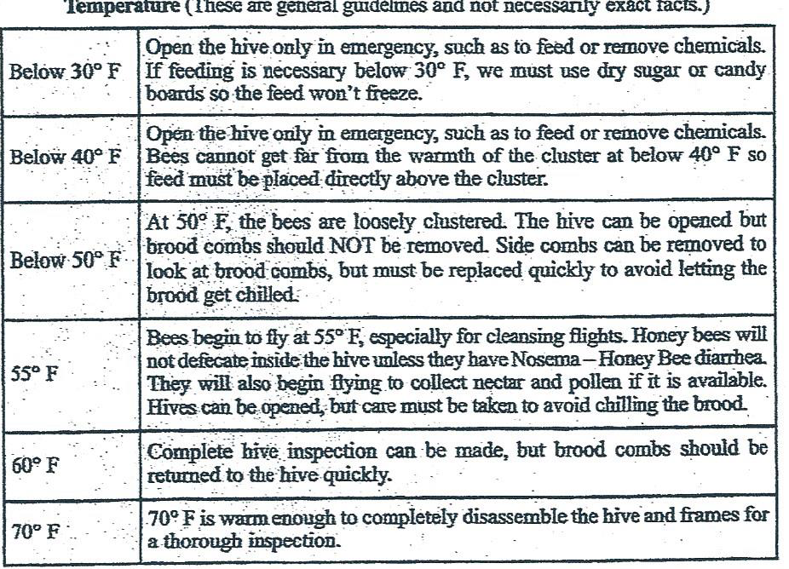

Slide 7
HIVE INSPECTION CHECKLIST ITEM
TRAFFIC AT ENTRANCE
High Traffic = 1 or more bees landing or leaving per second
  Expect high traffic in mid-morning on a warm day when pollen and nectar are available
Medium Traffic = 1 bee landing every 4 or 5 seconds
  Cool weather , high wind or slow nectar flow
Low traffic = 1 bee landing or leaving every 10 seconds or longer

Slide 8
HIVE INSPECTION CHECKLIST ITEM
Bees Crawling On The Ground
Indicator of possible problem
  More than half of a dozen bees crawling on the ground in front of the hive is a indication of sick bees maybe
Touch the bees to see if they can fly
  If they don’t fly, check their wings
    If wings are tattered on lower edge. Bees are worn out no problem
    If wings are deformed, there are likely mites in the hive
      Need to do mite count and treat if required

Slide 9
HIVE INSPECTION CHECKLIST ITEM
Bees Bringing In Pollen
If bees are bring in many loads of pollen
  It’s a good sign of brood rearing and all is well
  Very few or no loads of pollen at all when you know brood rearing is heavy is a cause to inspect the hive
  Bees need pollen (protein) for raising brood
    No pollen in combs. Means you need to feed a pollen supplement so the bees can raise brood

Slide 10
HIVE INSPECTION CHECKLIST ITEM
Hive Beetles On the Lid
Normally, few beetles will be seen on the lid
If any beetles seen in the hive must treat
  Use Small Hive Beetle Grease
  Use Small Hive Traps
  Use screened bottom board with oil tray

Slide 11
HIVE INSPECTION CHECKLIST ITEM
Feeder In Place
Just information

Slide 12
HIVE INSPECTION CHECKLIST ITEM
Number Of Frames Of Sealed Brood
Brood Viability
A measure of the growth of the hive and the performance of the queen
Number of frames of sealed brood should increase from winter to spring – 8 or 10 frames in April.
  Have to estimate how many full frames of brood (both sides) all the patches add up to
  Compare the amount of brood to the last inspection

Slide 13
HIVE INSPECTION CHECKLIST ITEM
Open Brood
Open brood in different stages of development (different sized larvae),
  Gives an opportunity to check the heath of the brood (healthy brood is white and looks moist)
  Any larvae dark, looks dry or has dissolved into ‘goo’ there is some disease present
    1 or 2 cells may not be a problem
    12 or more cells of sick brood requires some action or treatment
  Small larvae indicate that the queen has recently been present

Slide 14
HIVE INSPECTION CHECKLIST ITEM
Eggs, Open Nectar In The Combs
Eggs present is good sign the queen is OK, even if you do not see her
Open nectar usually indicates fresh nectar
  Means something is blooming and the hive is healthy and strong to collect it
  Hive may only have 2 deep frames of honey, but if it has fresh nectar, feeding won’t be necessary

Slide 15
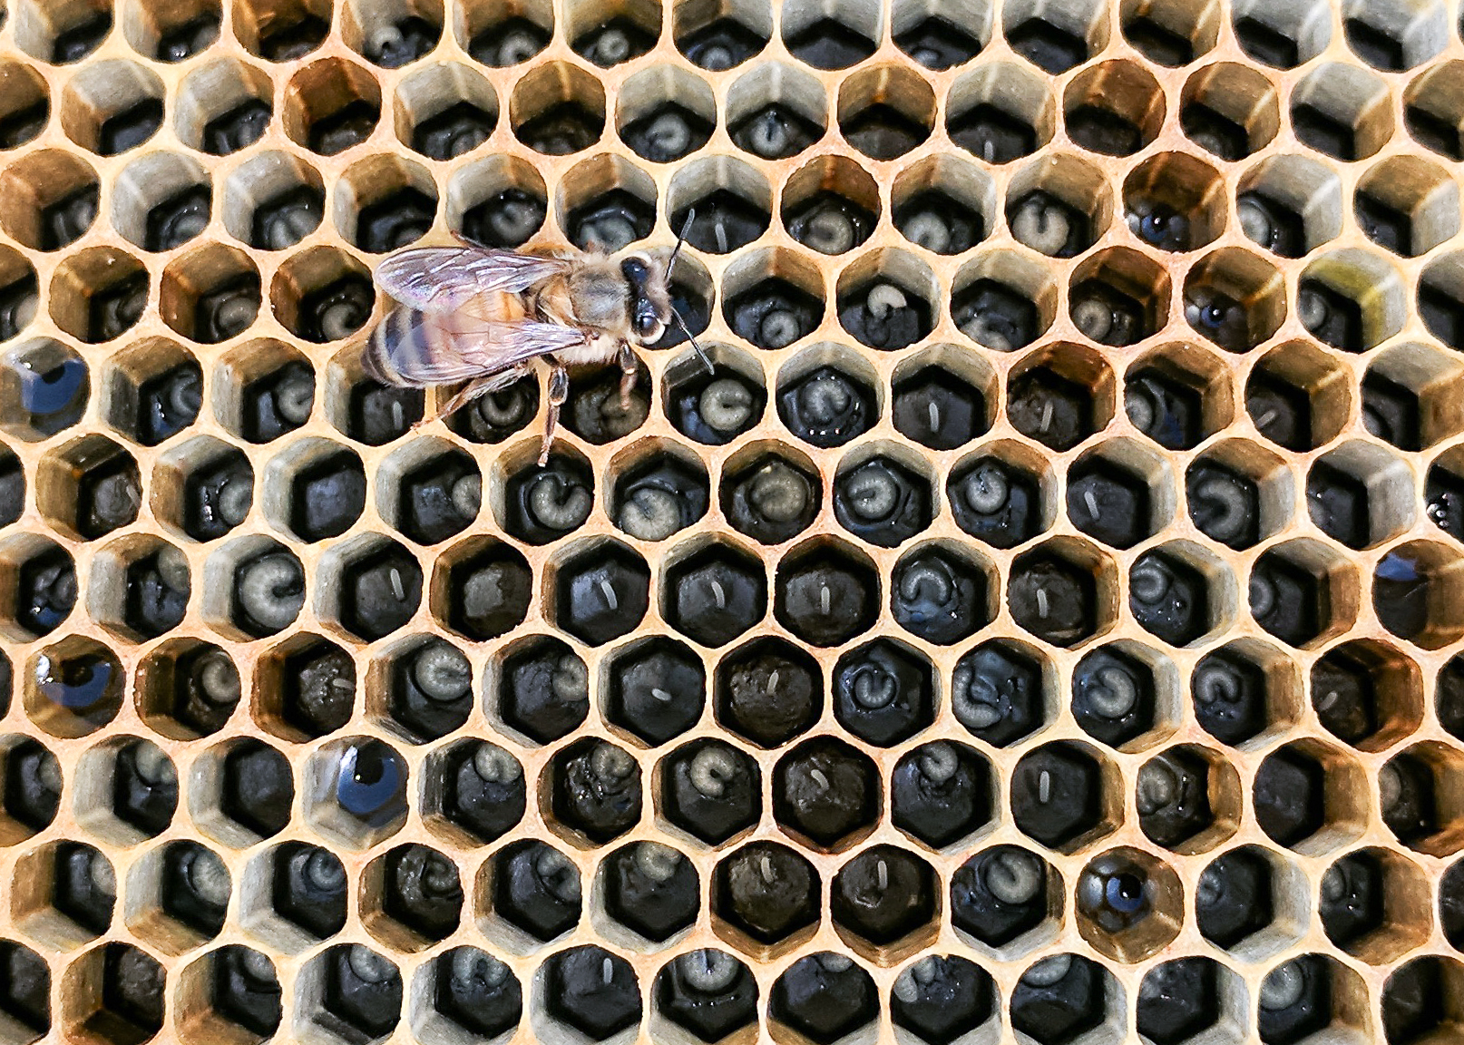

Slide 16
HIVE INSPECTION CHECKLIST ITEM
Small Larvae

Slide 17
HIVE INSPECTION CHECKLIST ITEM
Eggs
Eggs are present, a good sign the queen is OK
Even if you do not see her

Slide 18
HIVE INSPECTION CHECKLIST ITEM
Total Frames Of Bees, Total Frames of Brood
Used only for comparison to last inspection
  Count only the full frames of bees
  Take into account the difference in temperature and time of day
Cannot count the frames of brood until the temperature is 60 degrees F
  Want to see that there is a normal amount of brood for the season and conditions

Slide 19
HIVE INSPECTION CHECKLIST ITEM
Total Frames Of Honey, Number of Deep and Medium Boxes
Estimate how many deep frames all of it would be fill
Anytime honey stores are less than the equivalent of 2 deep frames either need to feed the hive or inspect it weekly to be sure they don’t run out

Slide 20
HIVE INSPECTION CHECKLIST ITEM
Total Number of Bad Combs, See the Queen, See the Queen Cells
Reminder to bring several good combs to the next inspection
  Bad combs are empty or nearly empty need to be REPLACE
Always good to see the queen
  Mark queen tells if it’s same queen or a new queen
  Queen’s abdomen should be plump with eggs
  Does she move gracefully
Did you see Queen Cells
  Supersedure or Swam cells

Slide 21
HIVE INSPECTION CHECKLIST ITEM
See Drones, Temperament
Did you see Drones
Temperament
  Calm, Average or Bad
    Colonies will have different attitudes on different days

Slide 22
HIVE INSPECTION CHECKLIST ITEM
Medications Added or Removed, Bottom Board
Writing an A or an R will show when a medication was added or removed
  Medication added write the date for removed
For solid bottom boards
  Clean , Average, Dirty
  Indication of colony strength and hygiene
Screened bottom boards are different situation
  Trash falls to the ground

Slide 23
HIVE INSPECTION CHECKLIST ITEM
Comments
Write the date at the beginning of the line to identify when the comment were made
  Comment may include questions or opinions
  EXAMPLES
    Action Taken
    What’s Blooming
    Next Inspection Date
    Action Needed

Slide 24
HIVE INSPECTION CHECKLIST SHEET
HIVE NUMBER # Dates:
Temperature
Traffic at Entrance: High Med Low
Bees Crawling on the Ground
Bees Bring in Pollen
Hive Beetles on the Lid
Feeder in Place
# Frames of Sealed Brood/ % V
#Frames of Open Brood
Any Sign of Brood Disease?
See Small Larvae?
See Open Nectar in Combs?
Total Frames of Bees
Total Frames of Honey
#Deep Boxes # Medium
# of Bad Combs
See the Queen?
See Queen Cells?
See Drones?
Temperament: Calm Avg. Bad
Medications Added or Removed
Bottom Broad: Clean Avg. Dirty
COMMENTS: Date, Action Taken. What Blooming? Next Inspection Date? Action Needed?

