Slide 1
“MEAD - Nectar of the Gods”

Slide 2
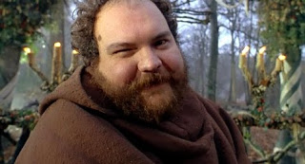
The Wisdom of Friar Tuck
“This is grain (honey), which any fool can eat,
but for which the Good Lord intended a more divine means of consumption.
Let us give praise to our Maker and glory to His bounty by learning about…
BEER (MEAD)!”

Slide 3
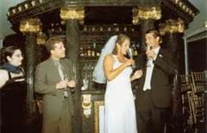
The History of Mead
Which is the oldest fermented beverage; Wine, Beer or Mead?
Definitely Mead!
How do we know this?
Mead making dates back to the Paleolithic Period, 8000 BC.
Simple, uses only 3 ingredients, water honey & yeast. (no brewing required).
Grapes not cultivated until much later.
The first mead likely the result of honey dripping from a hive into a pool of water.
Wild yeast fermented the honey into mead.
Ancients observed strange behavior in animals drinking the honey water.

Slide 4
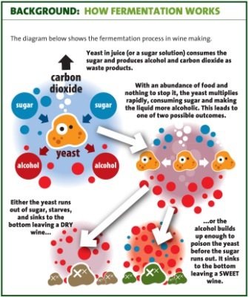
Fermentation; What & Why?
WHAT
Fermentation is the use of yeast to change sugar into ethyl alcohol and carbon dioxide or the use of bacteria to create lactic acid in certain foods.

Slide 5
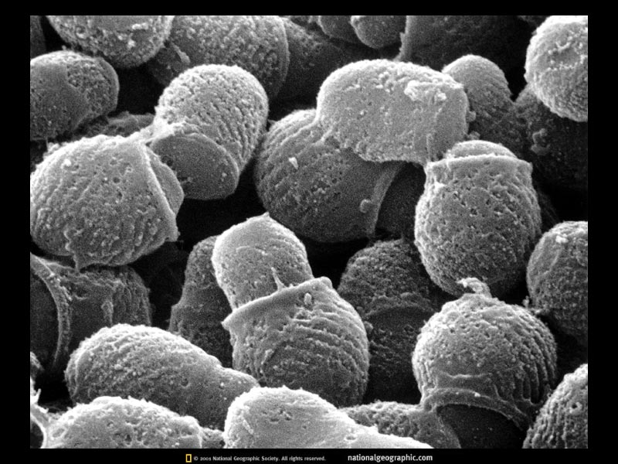
Yeast is a living organism
Are a group of unicellular fungi.
Exist naturally in the air (good & bad wine years).
Over 1,000 species
Saccharomyces Cerevisiae is most commonly used in beer, wine and mead making.
Different subspecies produce different flavors and levels of sweetness.

Slide 6
Fermentation; What & Why?
WHY
Preservation
Lack of Refrigeration, alcohol inhibits decomposition.
Used for centuries in Asia to preserve vegetables (Kimchee).
Lord Nelson’s body preserved in a rum barrel at Trafalgar.

Slide 7
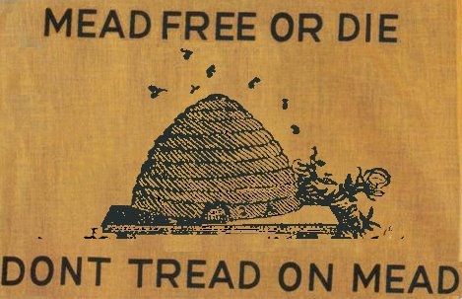
Fermentation; What & Why?
Why
Reduced bulk makes it easier and cheaper to move crops.
Water was often not safe or attractive to drink.
Alcohol (along with heating during brewing beer) kills any harmful organisms making it safe to drink (alcohol & the worm).
U.S.S. Constitution Revolutionary War sailing manifest.

Slide 8
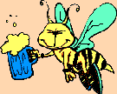
Is Mead Making Legal?
Yes! It is perfectly legal
Legislation signed in by President Carter in 1979.
States may still regulate production.
Florida allows a household to make 200 gallons per year.
If a single adult household, 100 gallons per year.
Distillation is still (no pun intended) illegal.
Freeze distillation is also illegal in Florida.

Slide 9
Can I Sell the Mead I Make?
Unless you have Federal and State licenses that allow you
to manufacture, transport and sell alcoholic beverages,
NO!
That’s called BOOTLEGGING! The mead you make is for your personal consumption.
You can however, give it away as long as the recipient is of legal age.

Slide 10
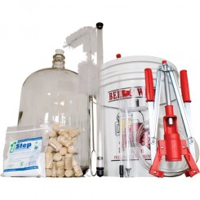
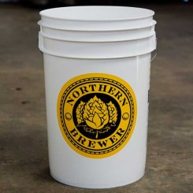
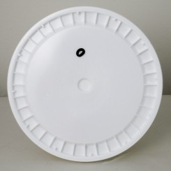
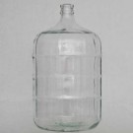
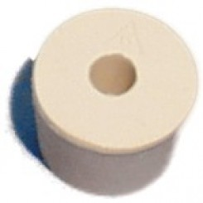
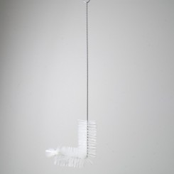
Mead Making Equipment
This equipment can also be used to make wine
Complete Kit
6.5 Gallon Fermentation Bucket w/ Drilled and Grommeted Lid
6.5 Gallon Carboy (glass or plastic) with a drilled stopper and a brush.

Slide 11
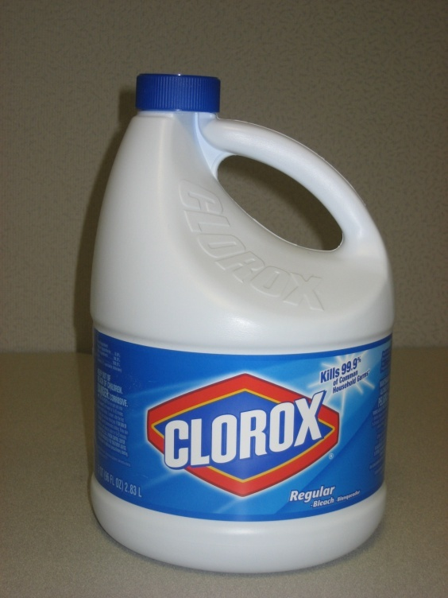
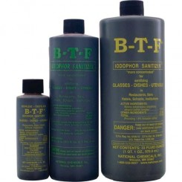
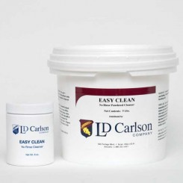
Mead Making Equipment
Sanitizers
Liquid (Iodophor)
Oxygen (no rinse)
Economy
½ tsp in 1 quart water
RINSE THOROUGHLY!
Uses iodine, stains equipment
RINSE THOROUGHLY!
My Favorite!

Slide 12
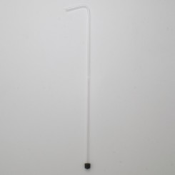
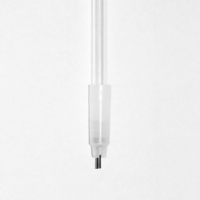
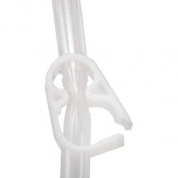
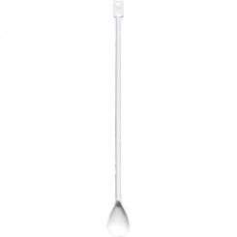
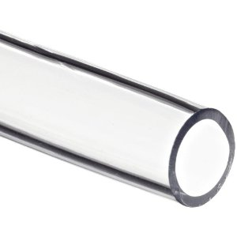
Mead Making Equipment
Straight Racking Cane (bottling)
Curved Racking Cane
Bottle Filling Tip
Long Handled Spoon
Food Grade Tubing
Hose Clamp

Slide 13
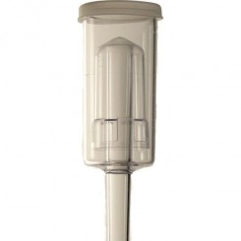
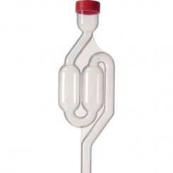
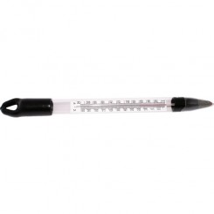
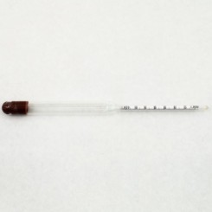
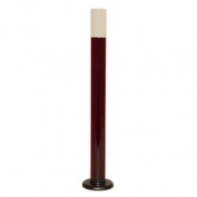
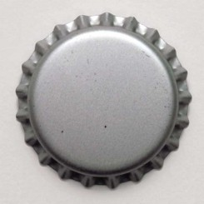
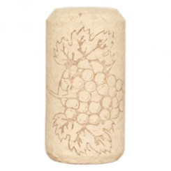
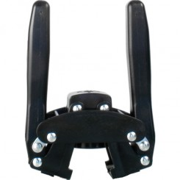
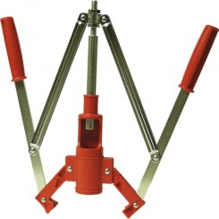
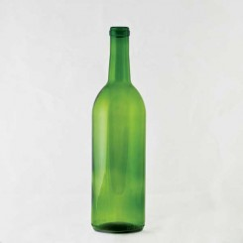
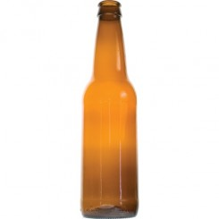
Mead Making Equipment
Airlock (1)
Airlock (2)
Thermometer
Hydrometer
Test Jar
Bottle Caps
Corks
Hand Capper
Hand Corker
Wine Bottles
Beer Bottles

Slide 14
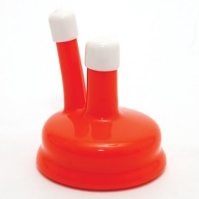
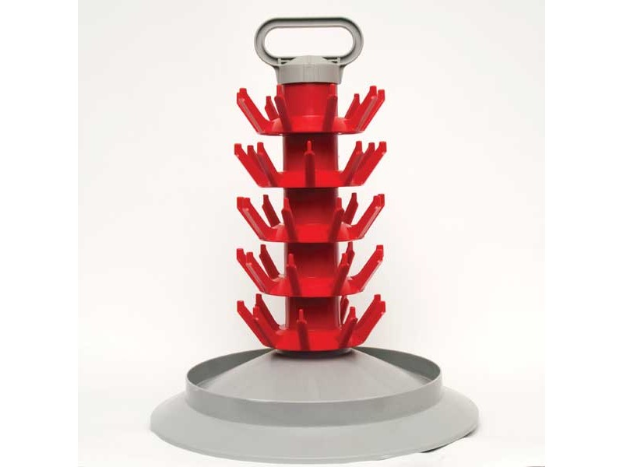
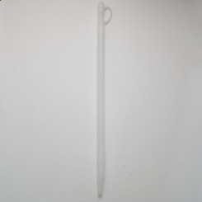
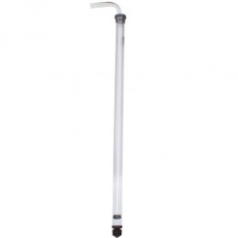
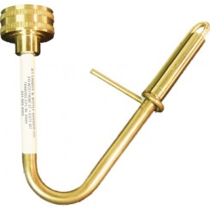
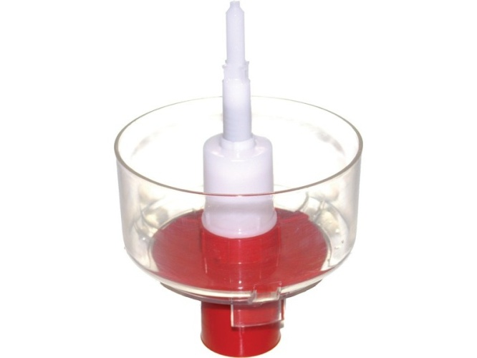
Mead Making Equipment
Nice to have, but not necessary
Carboy Cap
Bottle Draining Tree
Wine Thief
Auto Siphon
Jet Bottle Washer
Bottle Rinser

Slide 15
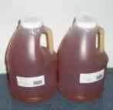
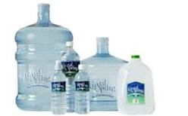
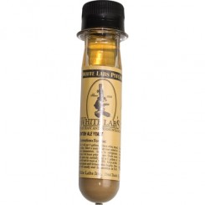
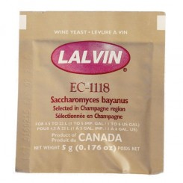
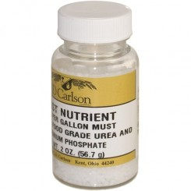
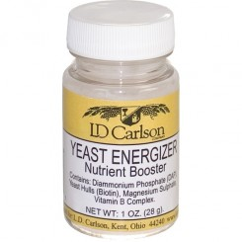
Mead Making Supplies
12-15 lbs Raw Honey.
Processed Honey will
NOT ferment.
Water, filtered or spring
Taste of water will affect
the taste of the mead.
Yeast (liquid)
Yeast (dry)
Yeast Nutrient
Ensures yeast remains
healthy during fermentation.
Yeast Energizer
Stimulates or restarts
Fermentation.

Slide 16
Mead Making Suppliers
Local
Just Brew It, 2670-1 Rosselle ST., Jacksonville, FL 32204
(904) 381-1983, www.justbrewitjax.com
Just Brew It, 1314 3rd ST. North, Jacksonville Beach, FL 32250
(904) 435-4767
Brew Bottle & Tap, 835 Park Ave., Orange Park, FL 32073
(904) 375-9123
Internet Mail Order
Northern Brewer, 6021 Lyndale Ave. S., Minneapolis, MN 55419
(800) 681-2739, www.northernbrewer.com
Leener’s, 9293 Olde Eight Road, Northfield, OH 44067
(800) 543-3697, www.leeners.com

Slide 17
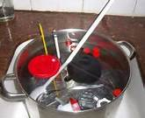
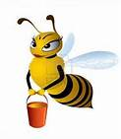
Mead Making Process
Primary Fermentation
Sanitize all equipment, VERY IMPORTANT!
Yeast & bacteria love unfermented sugars.
Not dangerous, nothing that can make you ill.
Can cause off flavors off flavors or spoilage.
Place honey jars in a hot water bath so it will pour easily.
Fill fermentation bucket with 3 gallons of water at room temperature.
Add yeast nutrient according to instructions and stir before adding honey.
Bring 3 quarts of water to a boil.
Pour honey into the fermentation bucket.
Use boiled water to dissolve remaining honey in jars and add to bucket.

Slide 18
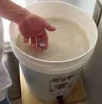
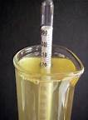
Mead Making Process
Primary Fermentation
Top up bucket with water bringing the volume up to 5 gallons (now called must).
Stir the must until all the honey is dissolved and well mixed (5-15 minutes).
Be sure and check the temp before adding yeast.
Take a hydrometer reading and note specific gravity.
Add yeast to the top of the must (no need to stir).
Seal bucket and install a sanitized airlock.
Fermentation should start within 24 hours (bubbling airlock).

Slide 19
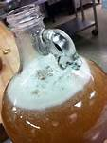
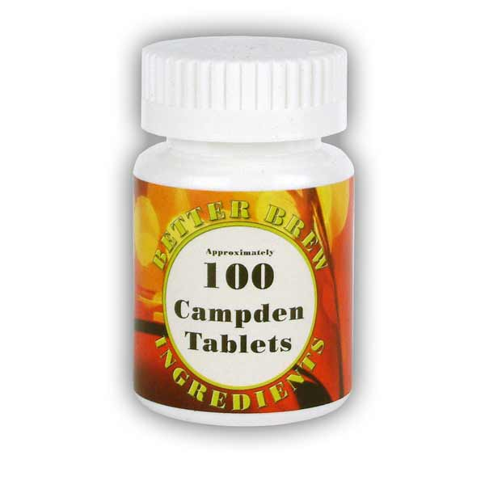
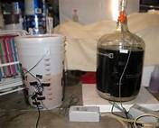
Mead Making Process
Secondary Fermentation (one to two weeks later)
Bubbles will slow and stop in the airlock.
Confirm this with a hydrometer reading (should read near zero).
You may add Campden tablets to prevent further fermentation.
Siphon the mead into a sanitized carboy w/ airlock.
Leave behind as much sediment as you can.
Let the mead clarify in the carboy.
If you wish, add a fining agent such as Isinglass (collagen).
Bottle when the mead has cleared.

Slide 20
Mead Making Process
Bottling
Sanitize bottles, siphoning and bottling equipment.
Carefully siphon mead into bottles and cap/cork.
Store in a cool dark place to age.
Bottles may be consumed as early as 2 weeks after bottling.
Age for 6 months or more for the peak flavor (Black Palmetto Honey).

Slide 21
Mead Making Process
To Carbonate Or Not To Carbonate, That Is The Question?
The Hard Way.
Dissolve honey into water .
Stir into the mead before bottling.
Be sure to use champagne bottles.
Seal with champagne corks & wire cages.
Age for 3 months to carbonate in the bottle.
The Easy Way.
Buy a Soda Stream home soda maker.
Pour finished mead into carbonation bottles and force carbonate

Slide 22
Complex Meads
Plain honey mead can be blended with fruit juices, wines herbs or grains to produce
Spectacular beverages. Each has it’s own unique name and here are a few of them.
Fruit Juices = “Melomel”
Apples, apple juice, or cider = “Cyser”
Grape juice or wine = “Pyment”
Combined with spices = “Hippocras”
Herbs or Spices = “Metheglin”
Grains = “Braggot”
Hydromel = Light Mead
Rodomel (Roman Empire) = Rose Petals

Slide 23
Suggested Reading
My Favorite

Slide 24
In the words of Benjamin Franklin.
“Wine (Mead) is sure proof that God loves us and wants us to be happy.“

